Slide 1
Real-Time Eulerian Fluid Sim
Ishan Ranade and Salaar Kohari
Real-Time Eulerian Water Simulation Using a Restricted Tall Cell Grid
Nuttapong Chentanez and Matthias Muller
NVIDIA PhysX Research

Slide 2
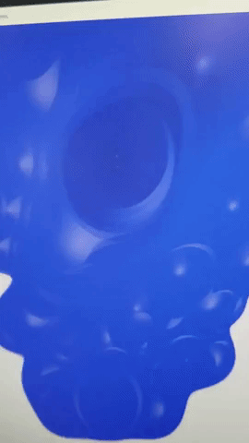
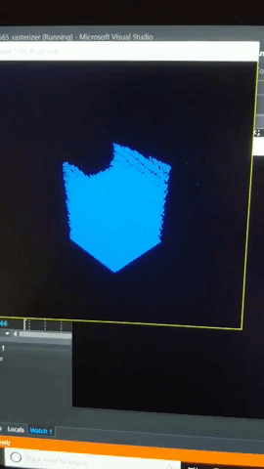
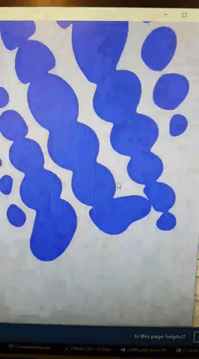
Milestone 1 Review

Slide 3
Milestone 2
Ray tracing with intersection instead of marching
Hierarchy structure for rendering acceleration
Water texture projection

Slide 4
Ray Casting
Ray-sphere intersections instead of ray marching for more speed and accuracy
Octree to reduce number of intersection tests

Slide 5
Textures
Water texture projection with modification depending on deformation/velocity

Slide 6
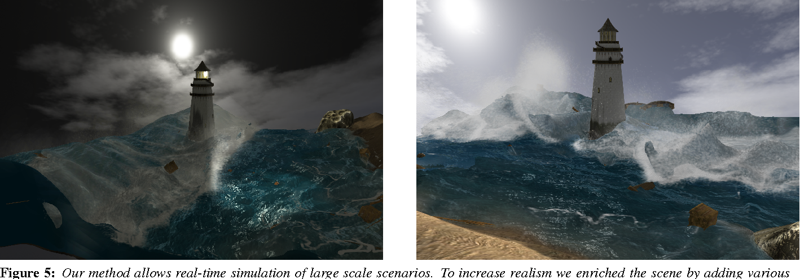
Remaining Work
Notes:
Explain that this counts for CIS 563

Slide 7
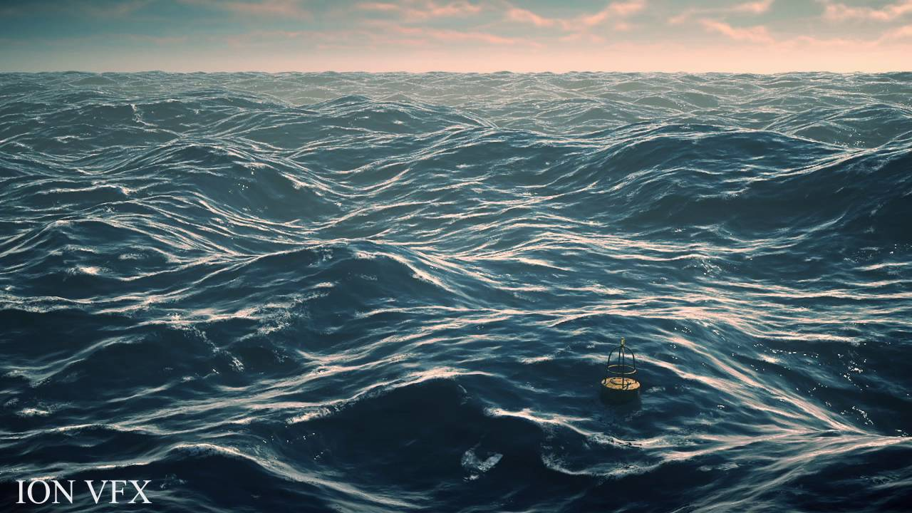
Scalability
Allow for real-time water simulation in a larger environment
Blend fake/simple simulation with main simulation

Slide 8
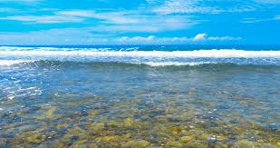
Translucency?
Render first pass without water
Render water pass and blend based on depth
Use angle of incidence for refraction/caustics

Slide 9
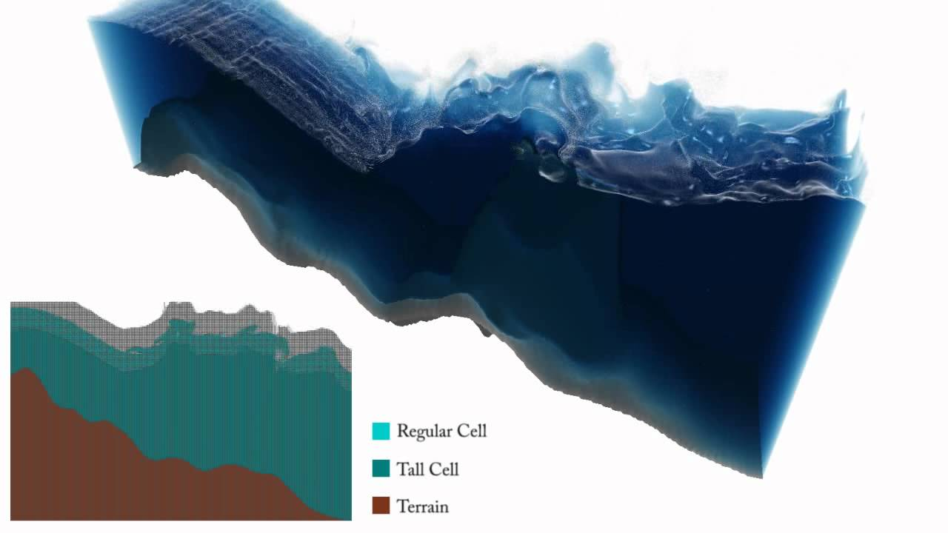
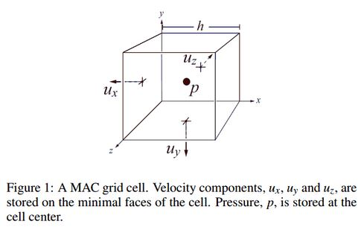
Tall Cells
Adaptive MAC grid with tall cells to reduce computation below the surface
Transition cells between regular and tall depending on distance to surface

Slide 10
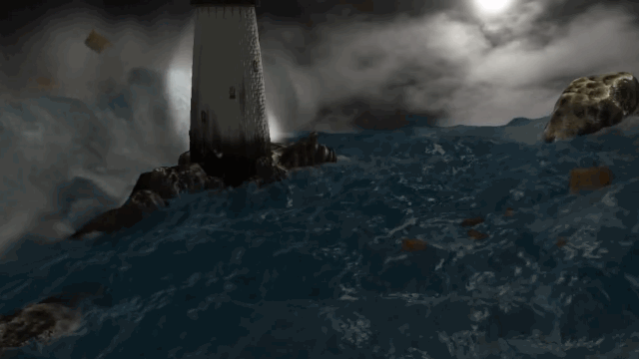
Notes:
Talk about simulation, real-time, rendering, interactive water and boxes

